Slide 1
Unit 7:Illumination and Shading

Slide 2
Illumination (Lighting)
An illumination model is used to calculate the intensity of a light that is seen at a given point on the surface of an object.
A surface-rendering algorithm uses the intensity calculations from an illumination model to determine the light intensity for all projected pixel positions for the various surfaces in a scene.

Slide 3
Shading
Apply the lighting model at a set of points across the entire surface
Shading

Slide 4
Illumination Model
The governing principles for computing the illumination
A illumination model usually considers:
  Light attributes (light intensity, color, position, direction, shape)
  Object surface attributes (color, reflectivity, transparency, etc)
  Interaction among lights and objects (object orientation)
  Interaction between objects and eye (viewing direction)

Slide 5
Illumination Calculation
Local illumination: only consider the light, the observer position, and the object material properties
θ

Slide 6
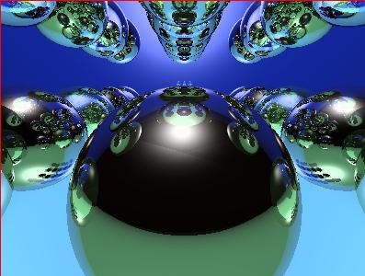
Illumination Models
Global illumination: take into account the interaction of light from all the surfaces in the scene
Example: Ray Tracing
object 4
object 3
object 2
object 1

Slide 7
Basic Light Sources
sun
Point light
Directional light
Spot light

Slide 8
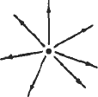
Light sources
Light sources are referred as light emitting object and light reflectors.
i. Point source: A point light source emits light equally in all directions from a single point.

Slide 9
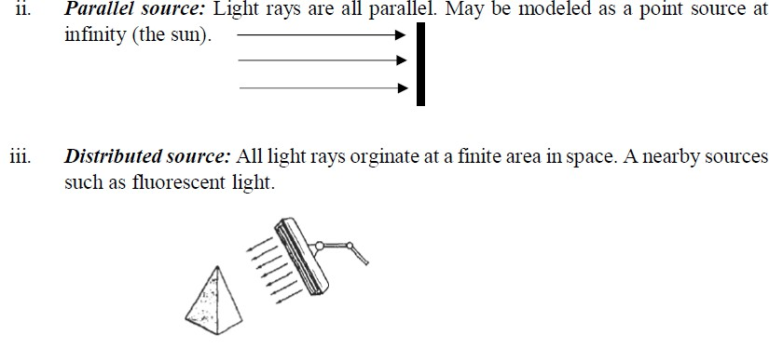

Slide 10
Basic illumination Model
Consider three types of light contribution to compute the final illumination of an object
  Ambient
  Diffuse
  Specular
Final illumination of a point (vertex) =
ambient + diffuse + specular

Slide 11
Ambient Light
A surface that is not exposed directly to a light source is still visible if nearby objects are illuminated. In our basic illumination model, we can set a general level of brightness for a scene. This is a simple way to model the combination of light reflections from various surfaces to produce a uniform illumination called the ambient light or the background light.
The amount of ambient light incident on each object is a constant for all surfaces and over all directions.

Slide 12
Ambient light calculation
Each light source has an ambient light contribution (I_{a})
Different objects can reflect different amounts of ambient (different ambient reflection coefficient Ka,
0 <= K_{a} <= 1)
So the amount of ambient light that can be seen from an object is:
Ambient = I_{a} * K_{a}

Slide 13
Diffuse Reflecftion
The amount of reflection from any surface depends on the surface property of the object. Dull, matte surfaces, such as chalk, exhibit diffuse reflection. Diffuse reflections are constant over each surface in a scene, independent of the viewing direction. The fractional amount of incident light that is diffusely reflected can be set with diffuse reflection coefficient k_{d} whose value can range from 0 to 1. A highly reflective surface has value k_{d} nearly equal to 1.

Slide 14
If a surface is exposed only to ambient light, we can express the intensity of the diffuse reflection at any point on the surface as:
I _{ambdiff} = K_{d} I_{a}
Since ambient light produces flat uninteresting shading, scenes are rarely rendered with ambient light alone. At least one light source is included in a scene, often as a point source in the viewing position

Slide 15
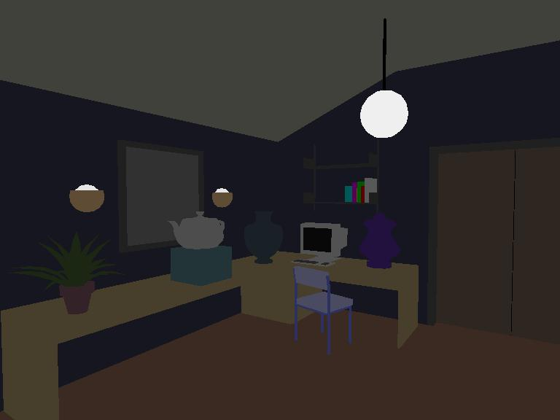
Ambient lighting example

Slide 16
We again assume similar approach that the diffuse reflections from the surface are scattered with equal intensity in all directions, independent of the viewing direction. Such surfaces are referred as ideal diffuse reflectors or Lambertian Reflectors.
The radiated light energy from any point on the surfaces is governed by the Lambert’s Cosine Law.

Slide 17
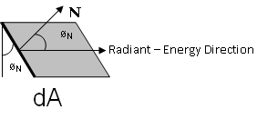
Lambert’s Cosine Law
This law states that the radiant energy from any small surface area dA in any direction ø_{N} is proportional to cosø_{N}. The light intensity depends on the radiant energy per projected area perpendicular to direction ø_{N}, which is dAcosø_{N}. Thus, for Lambertian Reflection, the intensity of light is same over all viewing directions.

Slide 18
Even though there is equal light scattering in all directions from a perfect diffuse reflector, the brightness of the surface does depend on the orientation of the surface relative to the light source. A surface that is oriented perpendicular to the direction of incident light appears brighter than if the surface were tilted at an oblique angle to the direction of the incoming light.

Slide 19
Consider a point light source with intensity I_{L.} If the angle of incidence is θ then the projected area of a surface perpendicular to the light direction is proportional to the cosθ.The diffuse reflection equation for a point on the surface is:
I_{L,diff}=k_{d}I_{L}cosθ
A surface is illuminated by a point source only if the angle of incidence is in the range 0º to 90º. When cosθ is negative, light source is “behind” the surface.

Slide 20
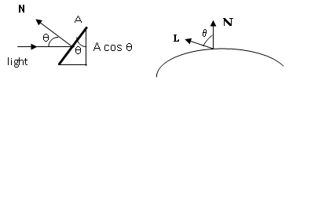
If N is the unit normal vector to a surface and L is the unit direction vector to the point light source from a position on the surface, then
cosθ=N.L
and the diffuse reflection equation for single point illumination is:
I_{L,diff}=k_{d}I_{L}(N.L)

Slide 21
The total diffuse reflection can be obtained by an expression that combines the ambient and point source intensity calculation. An additional parameter k_{a}, ambient-reflection coefficient, can be introduced to adjust the ambient light intensity for each surface. The total diffuse reflection equation can be written as:
I_{diff}= k_{a}I_{a +} k_{d}I_{L}(N.L)
K_{d} and k_{a} depends upon the material properties (from 0 to 1)

Slide 22


Diffuse light contribution
Diffuse light: The illumination that a surface receives from a light source and reflects equally in all direction
It does not matter where
the eye is

Slide 23
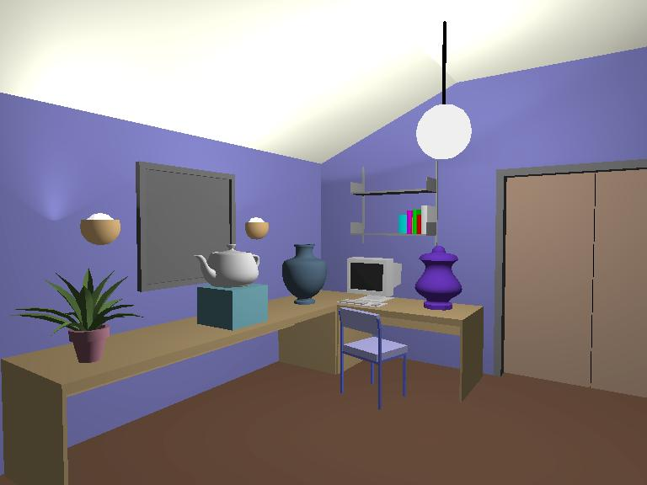
Diffuse lighting example

Slide 24
Diffuse light calculation
Need to decide how much light the object point receive from the light source – based on Lambert’s Law
Receive more light
Receive less light

Slide 25
Diffuse light calculation (2)
Lambert’s law: the radiant energy D that a small surface patch receives from a light source is:
D = I_{L} * cos (θ)
I: light intensity
θ: angle between the light vector and the surface normal
light vector (vector from object to light)
θ
N : surface normal

Slide 26
Diffuse light calculation (3)
Like the ambient light case, different objects can reflect different amount of diffuse light (different diffuse reflection coefficient K_{d}, 0 <= K_{d} <= 1))
So, the amount of diffuse light that can be seen is:
Diffuse = K_{d} * I_{L} * cos (θ)
N
L
θ
θ
cos(θ) = N.L

Slide 27

Specular light contribution
The bright spot on the object
The result of total reflection of
the incident light in a concentrate
region
See nothing!

Slide 28
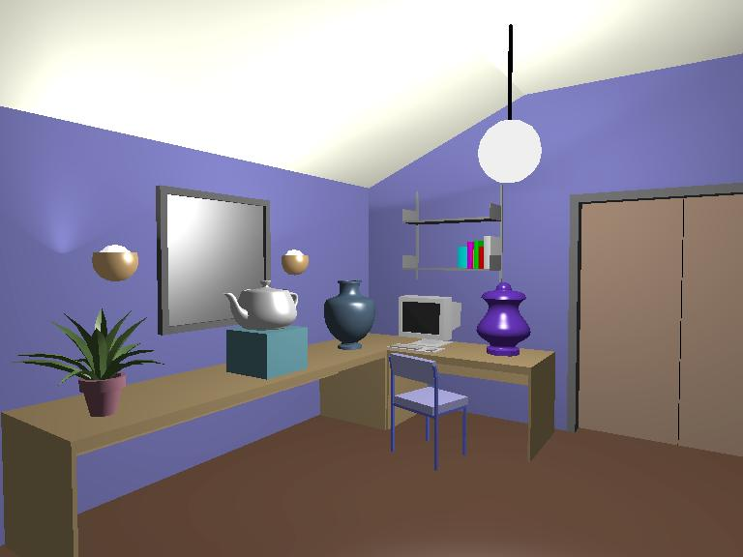
Specular light example

Slide 29
Specular light calculation
How much reflection you can see depends on where you are
The only position the eye can see specular from P
if the object has an ideal reflection surface
But for a non-perfect surface you will
still see specular highlight when you move
a little bit away from the idea reflection
direction
When φ is small, you see more specular
highlight
θ ?
φ
p

Slide 30
Specular light calculation (2)
Phong lighting model
specular = K_{s} * I_{L} * cos^{n}_{s}(φ)
K_{s}: specular reflection coefficient
N: unit normal surface vector;R:unit vector in the direction of ideal specular reflection
L:unit vector towards the point light source
I_{L}: light intensity
φ: angle between V and R( 0 to 90⁰ )
cos^{n}_{s}(φ): the larger is n_{s}, the smaller
is the cos value
cos(θ) = R.V
L
N
R
θ θ
φ
V
p

Slide 31

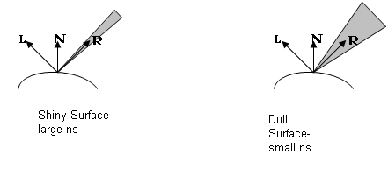

Slide 32


Specular light calculation (3)
The effect of ‘n_{s}’ in the phong model
n = 10
n = 90
n = 30
n = 270

Slide 33
Put it all together
Illumination from a light:
Illum = ambient + diffuse + specular
= K_{a} * I_{a} + K_{d} * I_{L} * (N.L) + K_{s} * I_{L} * (R.V)^{n}_{s}
If there are N lights
Total illumination for a point P = Σ (Illum)
H (halfway vector): halfway between V and L: (V+L)/2
or
(N.H)

Slide 34
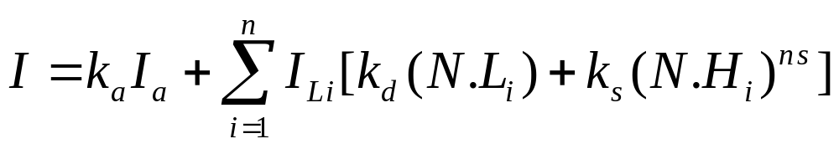
For multiple light sources
  Repeat the diffuse and specular calculations for each light source
  Add the components from all light sources
  The ambient term contributes only once

Slide 35
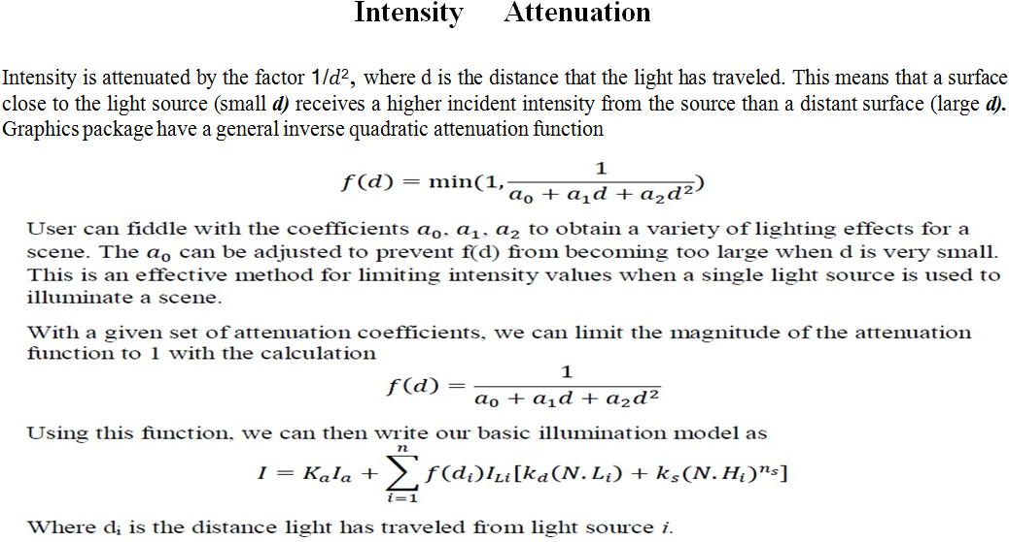

Slide 36
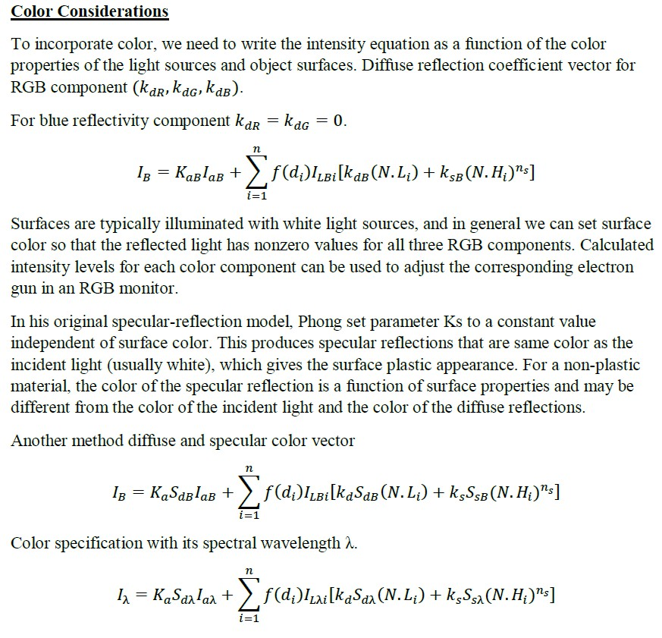
Color Considerations
To incorporate color, we need to write the intensity equation as a function of the color properties of the light sources and object surfaces. Diffuse reflection
coefficient vector for RGB component (𝑘_{𝑑𝑅} , 𝑘_{𝑑𝐺} , 𝑘_{𝑑𝐵} ).
For blue reflectivity component 𝑘_{𝑑𝑅} = 𝑘_{𝑑𝐺} = 0.
𝑛
𝐼_{𝐵} = 𝐾_{𝑎𝐵}𝐼_{𝑎𝐵} + ∑ 𝑓(𝑑_{𝑖})𝐼_{𝐿𝐵𝑖}[𝑘_{𝑑𝐵} (𝑁. 𝐿_{𝑖}) + 𝑘_{𝑠𝐵}(𝑁. 𝐻_{𝑖})^{𝑛𝑠}]
𝑖=1

Slide 37
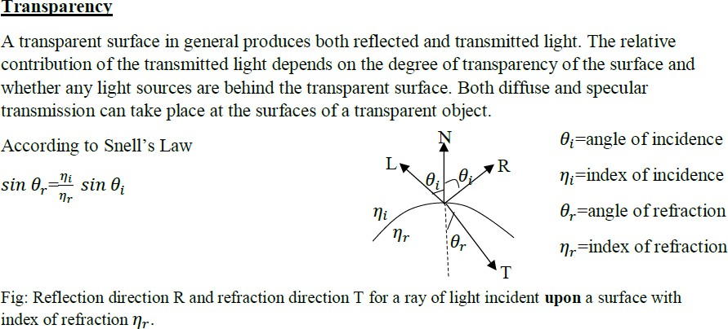

Slide 38
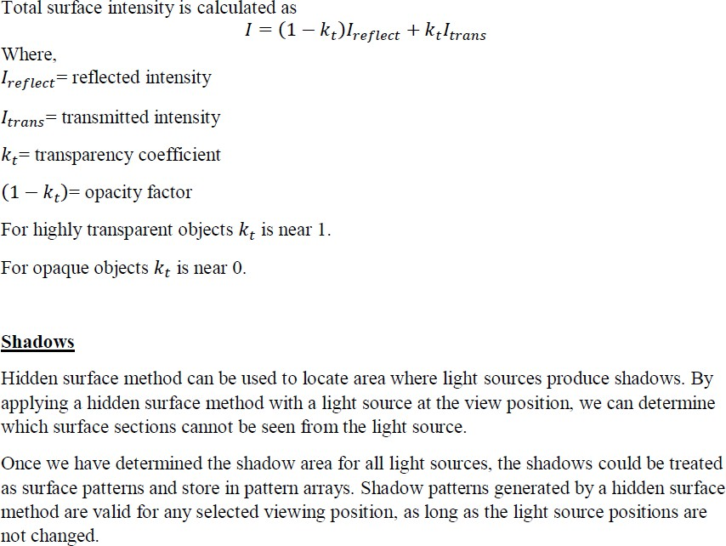

Slide 39
Polygon Rendering Method
  Constant intensity shading method
  Gouraud shading method (Intensity Interpolation)
  Phong shading mehod (Normal vector interpolation)

Slide 40
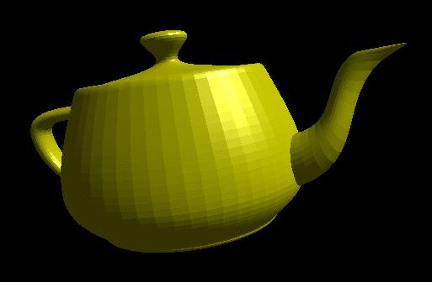

Polygon Rendering Method
Flat shading – compute lighting once and assign the color to the whole polygon

Slide 41
Flat shading (Constant Intensity Shading)
Only use one vertex (usually the first one) normal and material property to compute the color for the polygon
Benefit: fast to compute
Assumptions
  The object is not a curved (smooth) surface (e.g. a polyhedron object)
  The light source is very far away (so N.L does not change much across a polygon)
  The eye is very far away (so V.R does not change much across a polygon)
  The surface is quite small (close to pixel size)

Slide 42
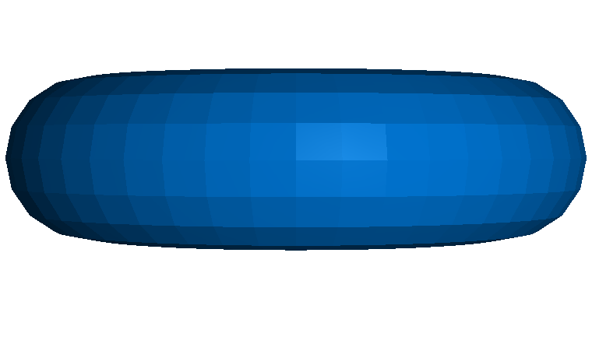
Mach Band Effect
Flat shading suffers from “mach band effect”
Mach band effect – human eyes accentuate the discontinuity at the boundary

Slide 43
Smooth shading
Reduce the mach band effect – remove value discontinuity
Compute lighting for more points on each face
Flat shading
smooth shading

Slide 44
Smooth shading
Two popular methods:
  Gouraud shading
  Phong shading

Slide 45
Smooth Shading
Need to have per-vertex normals
Gouraud Shading
  Interpolate color across triangles
  Fast, supported by most of the graphics accelerator cards
Phong Shading
  Interpolate normals across triangles
  More accurate, but slow. Not widely supported by hardware

Slide 46

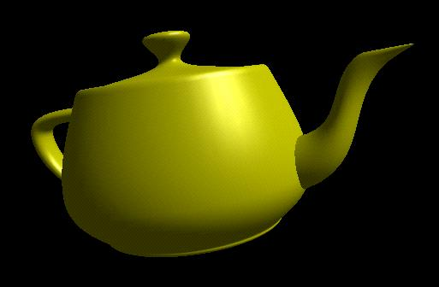
Gouraud Shading
Gouraud shading , also called intensity interpolating shading or color interpolating shading, eliminates intensity discontinuities that occur in flat shading.
Lighting is calculated for each of the polygon vertices
Colors are interpolated for interior pixels

Slide 47
Gouraud Shading (2)
Per-vertex lighting calculation
Normal is needed for each vertex
Per-vertex normal can be computed by averaging the adjust face normal
n1
n
n2
n3
n4
n = (n1 + n2 + n3 + n4) / 4.0

Slide 48
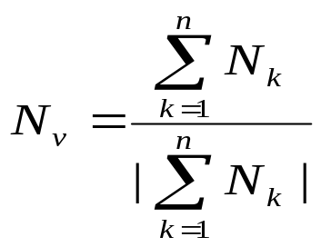
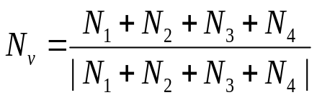
Steps
Step1: Determine the average unit normal vector at each vertex. At each polygon vertex, we obtain a normal vertex by averaging the surface normals of all polygons sharing the vertex as:
N₂
N₁
Nv
N₄
N₃

Slide 49
where N_{v} is normal vector at a vertex sharing four surfaces as in figure
Once N_{v} is known, intensity at the vertices can obtain from lighting model.
Step 2:Apply illumination model to calculate each vertex intensity.
Step 3:Linearly interpolate the vertex intensity over the surface of the polygon.
Once Nv is known, intensity at the vertices can obtain from lighting model.

Slide 50
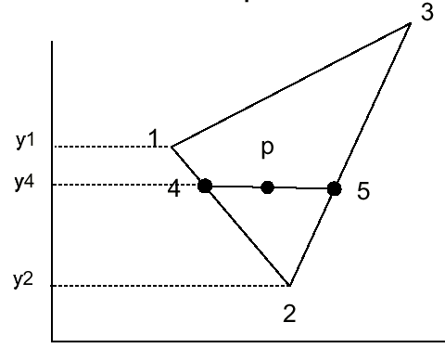
Linear Interpolation in a Triangle
To determine the intensity (color) of point P in the triangle,
determine the intensity of 4 by linearly interpolating between 1 and 2
determine the intensity of 5 by linearly interpolating between 2 and 3
determine the intensity of P by linear interpolating between 4 and 5

Slide 51
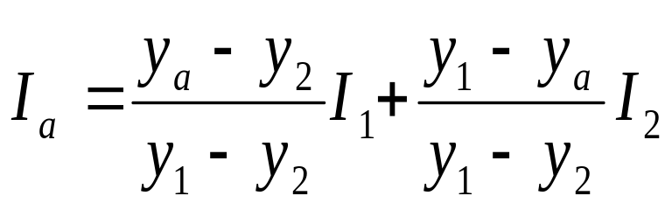
Here in figure, the intensity of vertices 1,2,3 are I1 , I2, I3 . are obtained by averaging normals of each surface sharing the vertices and applying a illumination model.
- For each scan line , intensity at intersection of line with Polygon edge are linearly interpolated from the intensities at the edge end point.
So Intensity at intersection point A, Ia is obtained by linearly interpolating intensities of I1 and I2 as
(x₁,y₁₎ I₁
(x₃,y₃₎ I₃
y_{a}
A
P
B
(x₂,y₂₎ I₂
x_{a}

Slide 52
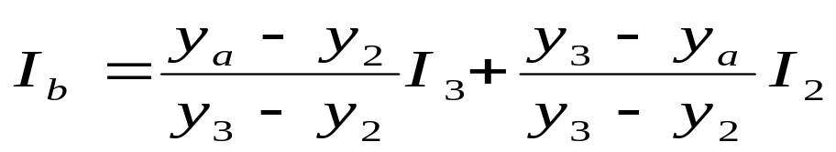
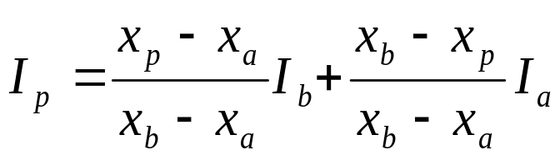
Similarly, the intensity at point B is obtained by linearly interpolating intensities at I₂ and I₃ as
The intensity of a point P in the polygon surface along scan-line is obtained by linearly interpolating intensities at I_{a} and I_{b} as,
Then incremental calculations are used to obtain successive edge intensity values between scan- lines

Slide 53
Linear interpolation
Interpolate triangle color: use y distance to interpolate the two end points in the scanline, and
use x distance to interpolate interior
pixel colors
x = a / (a+b) * v2 + b/(a+b) * v1
a
b
v1
x
v2

Slide 54
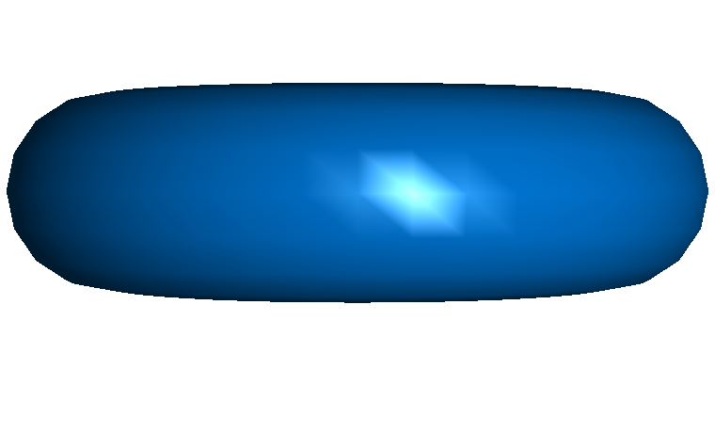
Gouraud Shading
Advantages: Removes intensity discontinuities at the edge as compared to constant shading.
Disadvantages: Highlights on the surface are sometimes displayed with anomalous shape and linear intensity interpolation can cause bright or dark intensity streak called mach-bands.
Gouraud Shading Vs Flat Shading

Slide 55
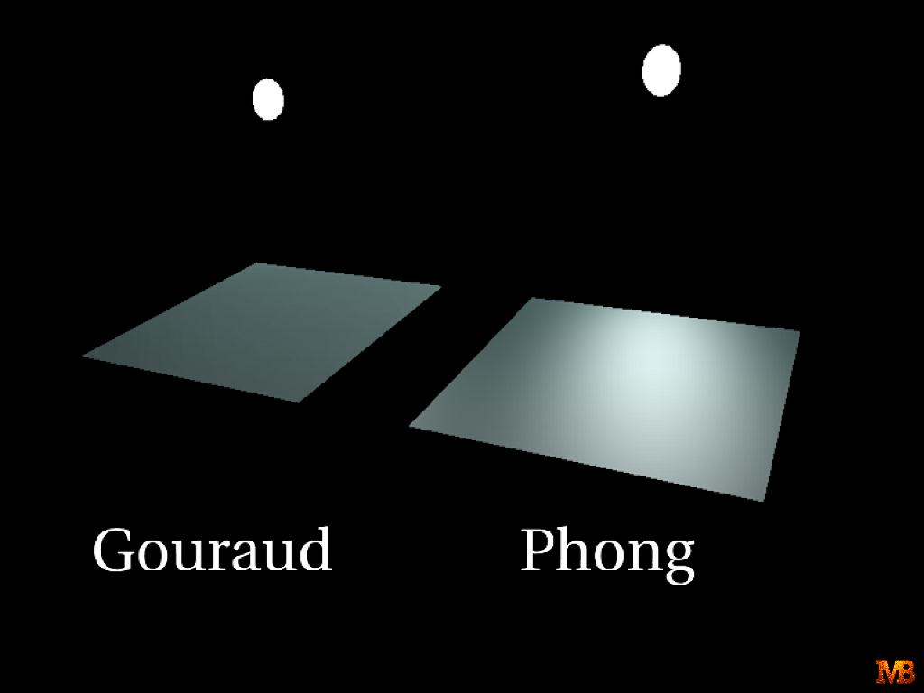
Gouraud Shading Problem
Lighting in the polygon interior can be inaccurate

Slide 56
Phong Shading Model
Gouraud shading does not properly handle specular highlights, specially when the n parameter is large (small highlight).
Reason: colors are interpolated.
Solution: (Phong Shading Model)
  1. Compute averaged normal at vertices.
  2. Interpolate normals along edges and scan-lines. (component by component)
  3. Compute per-pixel illumination.

Slide 57
Phong Shading
Instead of color interpolation, we calculate lighting for each pixel inside the polygon (per pixel lighting)
We need to have normals for all the pixels – not provided by the user
Phong shading algorithm interpolates the normals and compute lighting during rasterization

Slide 58
A more accurate method for rendering a polygon surface is to interpolate normal vector and then apply illumination model to each surface point. This method is called Phong shading or normal vector interpolation method for shading. It displays more realistic highlights and greatly reduce the mach band effect.
A polygon surface is rendered with Phong shading by carrying out following calculations.
- Determine the average normal unit vectors at each polygon vertex.
- Linearly interpolate vertex normals over the surface of polygon.
-Apply illumination model along each scan line to calculate the pixel intensities for the surface point.

Slide 59
Incremental calculations are used to evaluate normals between scanlines and along each in-dividual scan line as in Gouraud shading.
Phongshading produces accurate results than the direct interpolation but it requires considerably more calculations.
Slow – not supported by OpenGL and most of the graphics hardware

Slide 60
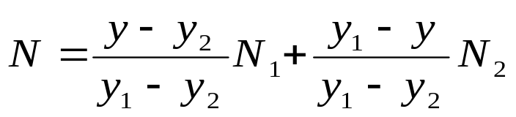
In figure, N1, N2, N3 are the normal unit vectors
at each vertex of polygon surface. For scan-line
that intersect an edge, the normal vector N can be
obtained by vertically interpolating normal vectors
of the vertex on that edge as.
N₁
N₃
(x₁,y₁₎
(x₃,y₃₎
N
y
x
N₂
(x₂,y₂₎
x

Slide 61
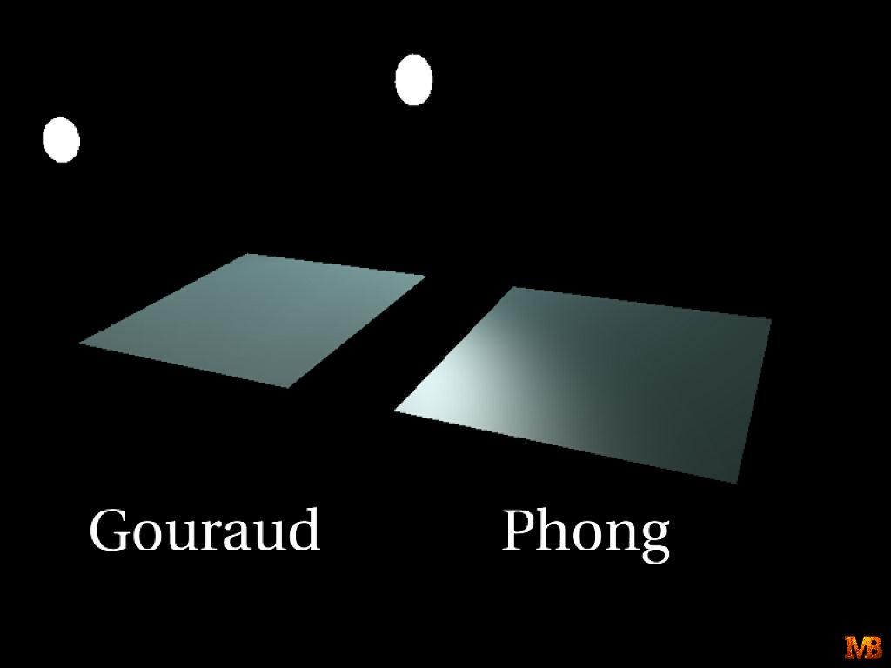

Slide 62
Rendering polygons
Phong surface rendering:
Even better result for curved surfaces
No errors at high lights
No Mach banding
Silhouettes remain coarse
More expensive than flat or Gouraud shading

Slide 63
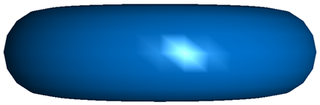
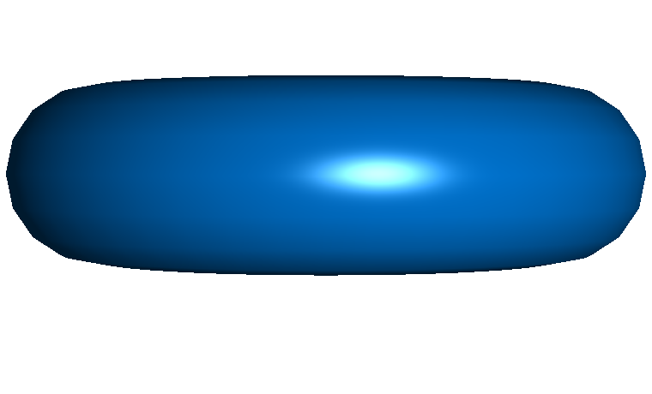
Rendering polygons
Flat
Gouraud
Phong

Slide 64
Fast Phong Shading
Fast Phong shading approximates the intensity calculations using a Taylor series expansion and Triangular surface patches.
Since Phong shading interpolates normal vectors from vertex normals , we can express the surface normal N at any point (x,y) over a triangle as
N = Ax + By + C
where A,B,C are determined from the three vertex equations.
N_{k}= Ax_{k} + By_{k}+ C, k = 1,2,3 for (x_{k}, y_{k}) vertex.

Slide 65
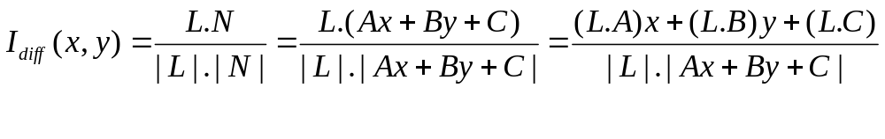
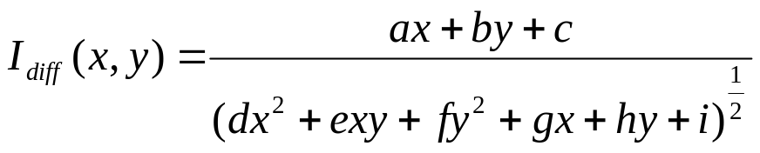
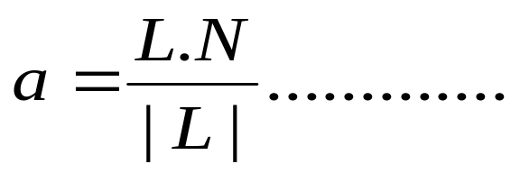
Omitting the reflectivity and attenuation parameters
Re writing this
------(1)
Where a, b, c, d….. are used to represent the various dot products as
and so on.

Slide 66
Finally, denominator of equation (1) can express as Taylor series expansions and relations terms up to second degree in x,y.
This yields,
where each T_{k} is a function of parameters a,b,c,d,……. And so forth.
This method still takes twice as long as in Gouraud shading. Normal Phong shading takes six to seven times that of Gouraud shading.

Slide 67
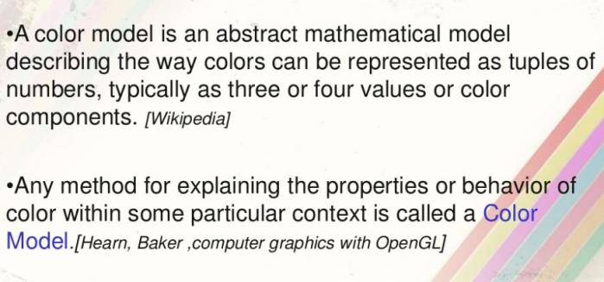
Color Models

Slide 68
